Slide 1
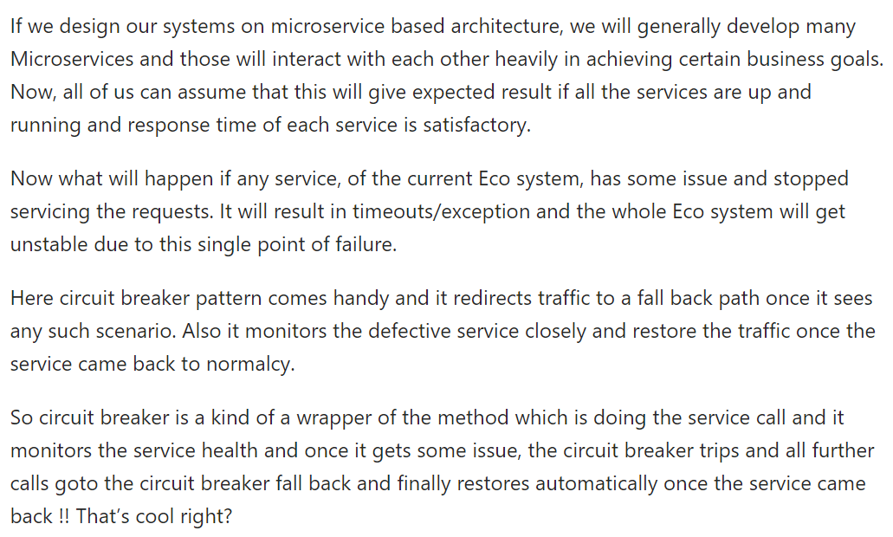
Hystrix Circuit Breaker

Slide 2
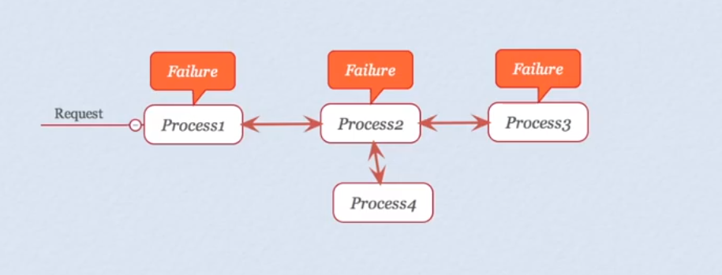
Spring Boot Hystrix

Slide 3
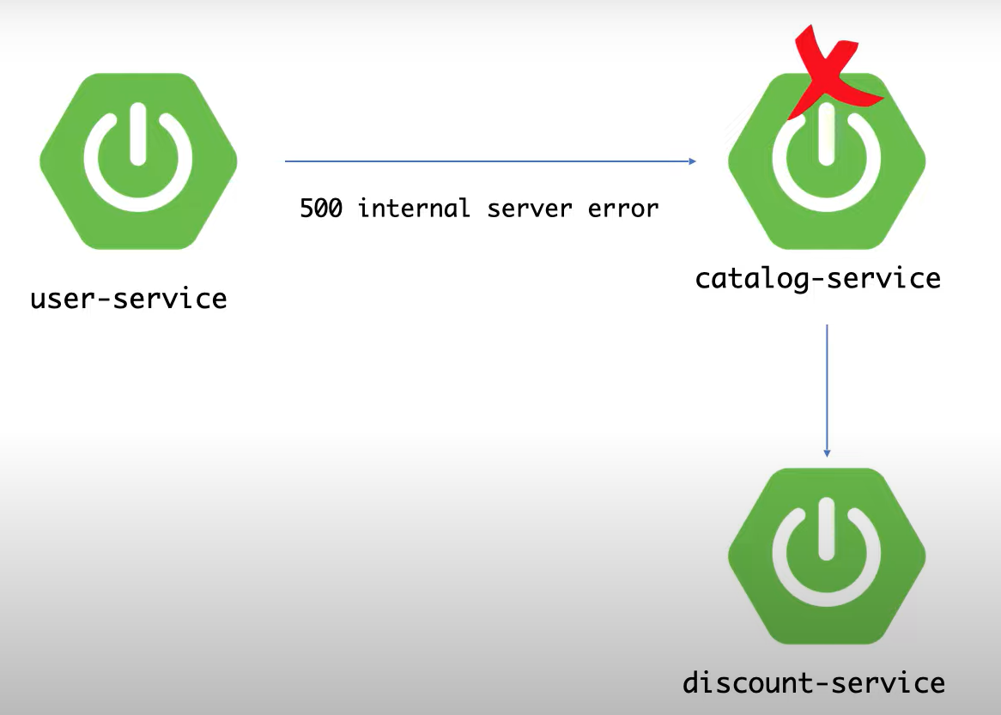
Spring Boot Hystrix

Slide 4
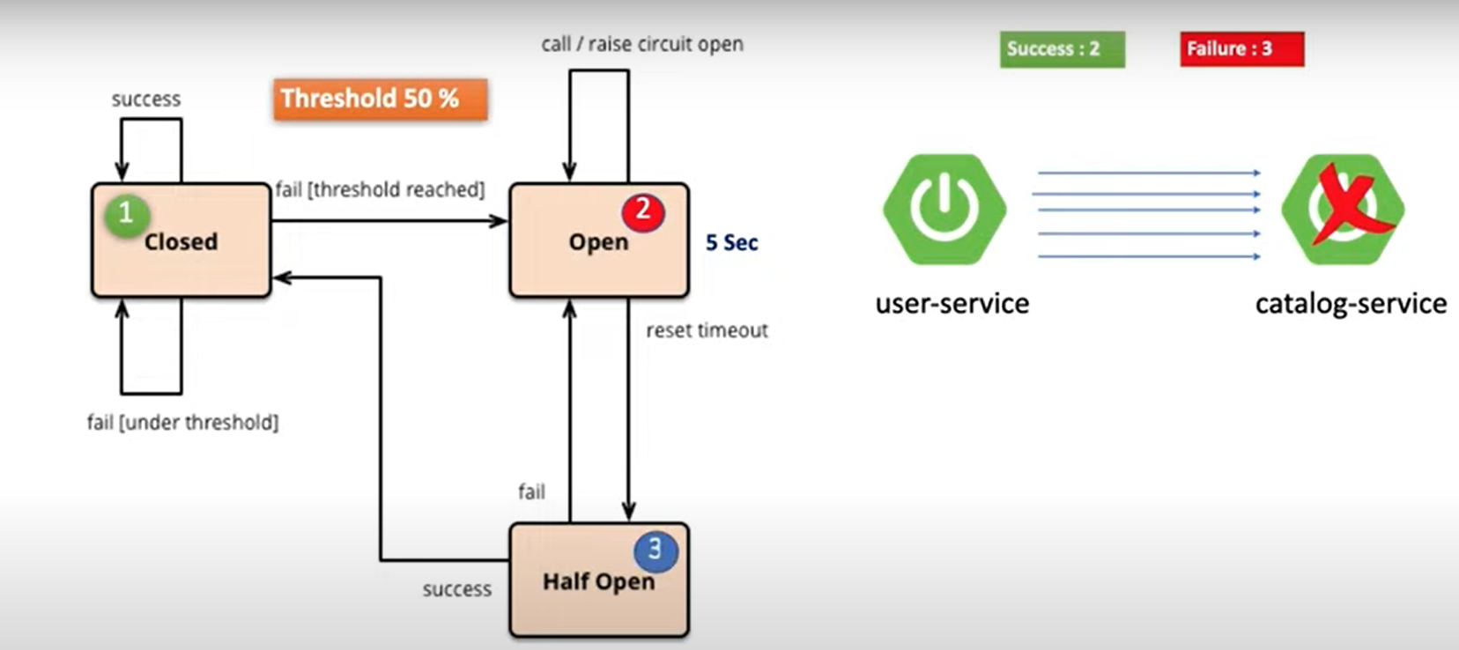
Spring Boot Hystrix

